Slide 1

Machine learning
By: Shadi M. Alkhatib

Slide 2
The roadmap for ML
1- Introduction to Machine Learning
2- Types / Approach of Machine Learning
3- Machine Learning Projects / Use Cases
4- Machine Learning Project Life-Cycle
5- ML – The difference between classification Vs regression
6- Unsupervised ML – Clustering Algorithms:
K-means Clustering
7- Supervised ML – Regression and Classification Algorithms:
Linear Regression
KNN
Logistic Regression
Support Vector Machine
Decision Tree
Random Forest
Naïve bayes
8- Deployment ML Models

Slide 3
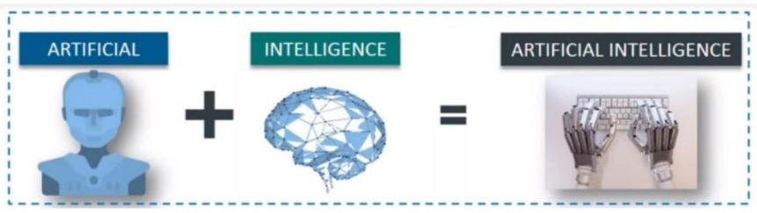
Artificial Intelligence - AI
Intelligence is the ability to learn or understand or to deal with new or trying situations. The ability to calculate, perceive, learn from experience, store, retrieve, solve problems and so on.
Artificial Intelligence (AI) is a branch of computer science, Technique that enable machines to mimic of human behaviour.

Slide 4
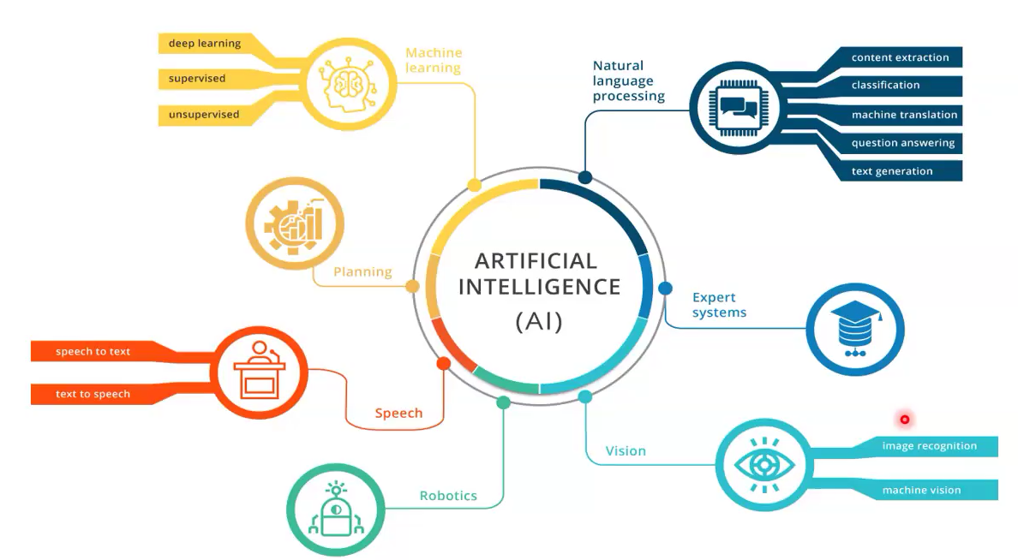
Main branches of AI

Slide 5
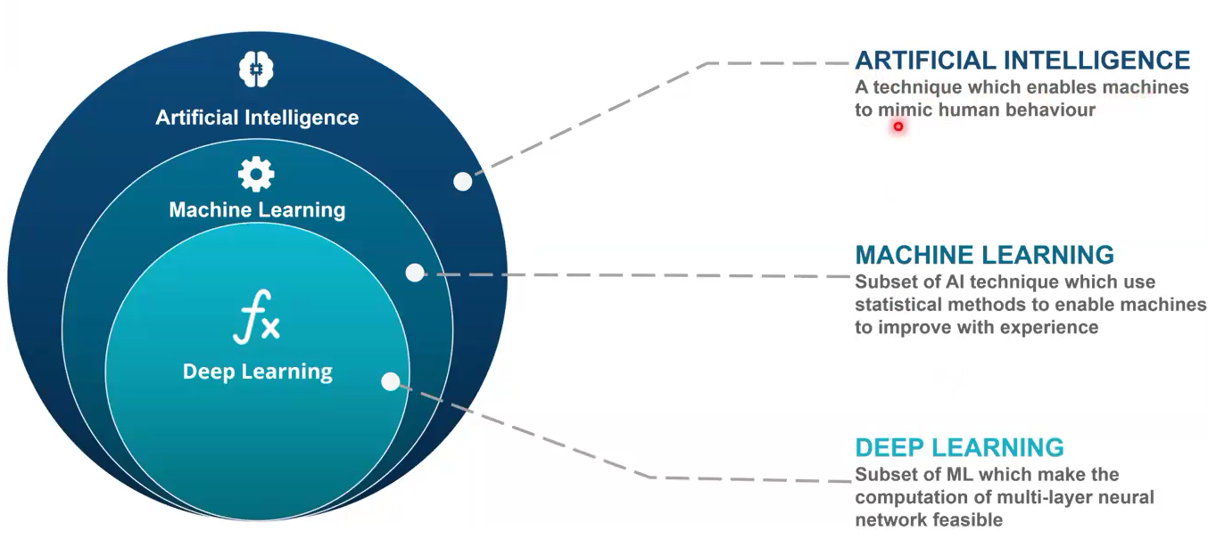
Branches of AI

Slide 6
Three types of AI
1- Artificial Narrow Intelligence: Don't hold the ability to form memories or use past experiences to make decisions.
2- Artificial General Intelligence: Uses past experience and the present data to make a decision, the best example of this Al type is autonomous cars.
3- Artificial Super Intelligence: Smarter than the human mind and can perform any task better. example can be socialize, understand human emotions and self-awareness.

Slide 7
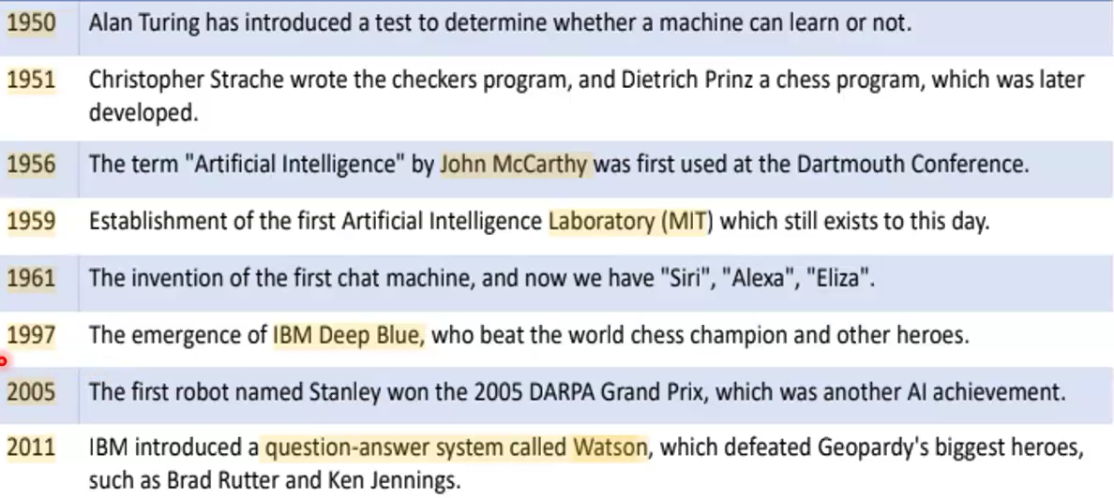
History of AI

Slide 8
Terms about AI & ML & DL
AI: Technique that enable machines to mimic of human behaviour.
ML: Coined by Arthur Samuel in 1959. which is a computer program (subset of Al) which provides the machine ability to learn automatically and improve from experience without being explicitly programmed. OR ML Use Set of Method to enable machines improves its experience and decision making
DL: Use Neural network to solve complex challenges. Similar to the human nervous system

Slide 9
Machine Learning - ML
If we say Machine Learning without data as we say omelet without eggs
Machine learning - ML is a subfield of artificial intelligence
Field of study that gives computers the capability to learn without being explicitly programmed
Machine learning starts with data : Texts, numbers, photos
Data can be from different resources : bank transactions, pictures of people, time series data from sensors, or sales reports
Data is gathered and prepared to be used as training data into a machine learning algorithm

Slide 10
Machine Learning - ML VS Deep Learning - DL
Factor | Machine Learning | Deep Learning
Data Requirement | Little data is required | It needs a lot of data
Data Example | Numeric | Numeric, Images, Texts, Audios, Videos,…etc.
Accuracy | Lesser accuracy | Higher accuracy
Training Time | Less time to train | Long time to train
Hardware needed | Train on CPU | Requires GPU

Slide 11
The roadmap for ML
1- Introduction to Machine Learning
2- Types / Approach of Machine Learning
3- Machine Learning Projects / Use Cases
4- Machine Learning Project Life-Cycle
5- ML – The difference between classification Vs regression
6- Unsupervised ML – Clustering Algorithms:
K-means Clustering
7- Supervised ML – Regression and Classification Algorithms:
Linear Regression
KNN
Logistic Regression
Support Vector Machine
Decision Tree
Random Forest
Naïve bayes
8- Deployment ML Models

Slide 12
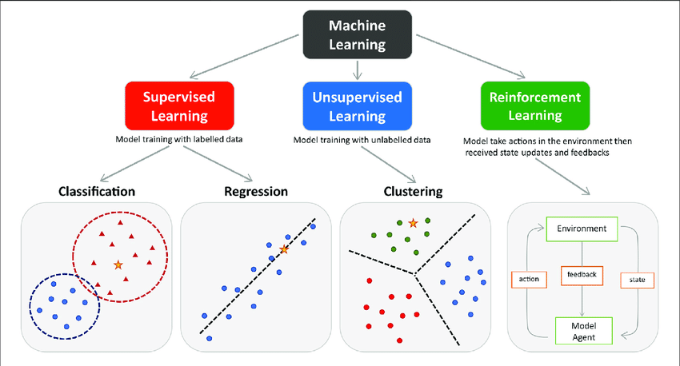
Types / Approach of Machine Learning - ML

Slide 13
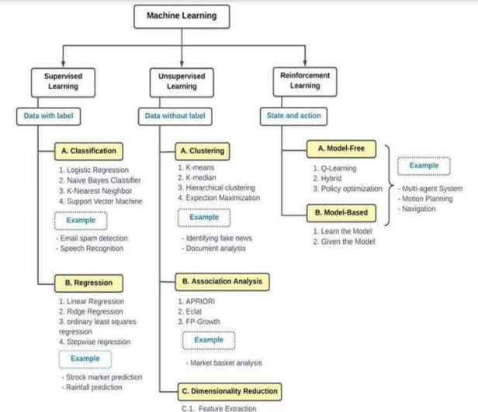

Slide 14
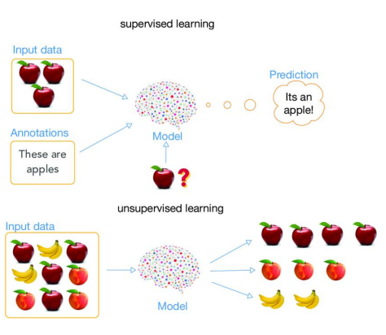
Supervised & Unsupervised Learning ML

Slide 15
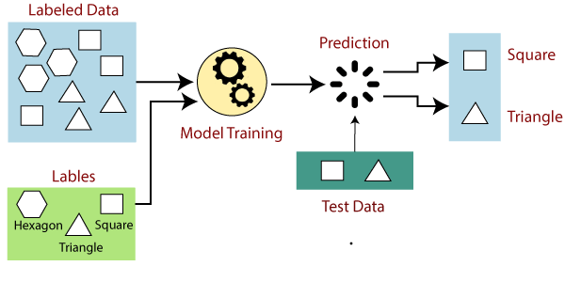
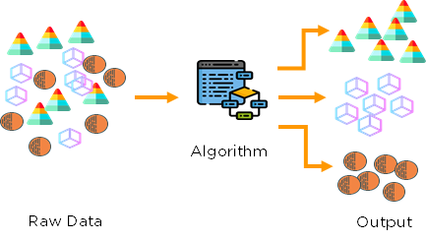
Types of Machine Learning - ML
1- Supervised
Train the machines using the labelled dataset
Labelled data specifies the inputs are already mapped to the output
2- Unsupervised
The machine is trained using the unlabeled dataset
The main goal is to group or categories the unsorted dataset according to the similarities, patterns, and differences
3- Reinforcement Learning
Works on a feedback-based process (State and action)
For example, a child learns various things by experiences in his day-to-day life
Notes:
Supervised Machine Learning
Suppose we have an input dataset of cats and dog images
1- we will provide the training to the machine to understand the images such as :
Shape & size of the tail of cat and dog
Shape of eyes
Color
Height (dogs are taller, cats are smaller), etc.
2- Start training by understanding the image and mapping it into specific label
3- When we input the picture of a cat and ask the machine to identify the object and predict the output
4- Now, the machine is well trained, so it will check all the features of the object, such as height, shape, color, eyes, ears, tail, etc., and find that it's a cat

Slide 16
The roadmap for ML
1- Introduction to Machine Learning
2- Types / Approach of Machine Learning
3- Machine Learning Projects / Use Cases
4- Machine Learning Project Life-Cycle
5- ML – The difference between classification Vs regression
6- Unsupervised ML – Clustering Algorithms:
K-means Clustering
7- Supervised ML – Classification and Regression Algorithms:
KNN
Logistic Regression
Support Vector Machine
Decision Tree
Random Forest
Naïve bayes
Linear Regression
8- Deployment ML Models

Slide 17
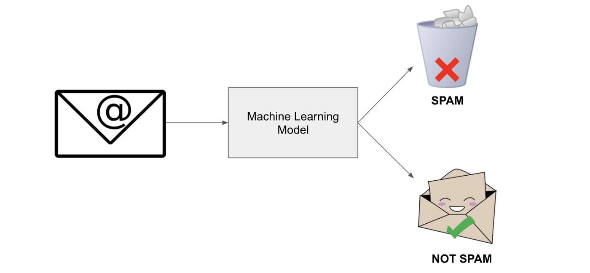
ML Projects / Use Cases - 1
Diabetes mellitus disease
Identifying Spam Email
Most of your email inboxes also have an Spam or not spam inbox
Where email provider automatically filters unwanted spam emails
Machine Learning model train to identify all the spam emails based on common characteristics such as the email, subject, and sender content

Slide 18
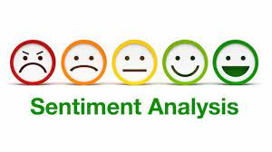
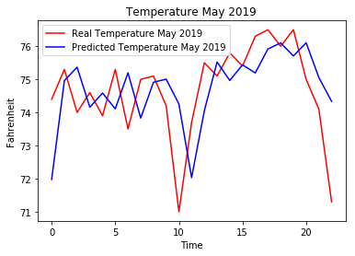
ML Projects / Use Cases - 2
Sentiment Analysis - Analyze feedback such as hospitals, hotel and restaurant
Help to determine the emotion or opinion of the speaker or the writer.
Weather Forecasting – Using time series
Machine Learning can be used to forecast weather with historical weather data
Based on observations of the weather in the past we can predict the weather in the future
Data collected from weather stations and satellites

Slide 19
The roadmap for ML
1- Introduction to Machine Learning
2- Types / Approach of Machine Learning
3- Machine Learning Projects / Use Cases
4- Machine Learning Project Life-Cycle
5- ML – The difference between classification Vs regression
6- Unsupervised ML – Clustering Algorithms:
K-means Clustering
7- Supervised ML – Classification and Regression Algorithms:
KNN
Logistic Regression
Support Vector Machine
Decision Tree
Random Forest
Naïve bayes
Linear Regression
8- Deployment ML Models

Slide 20
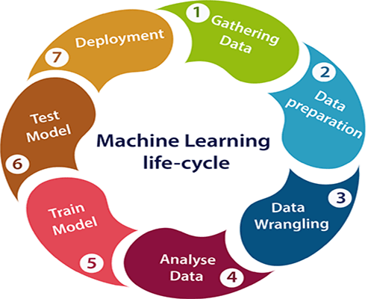
Machine Learning Project Life-Cycle - 1
1- Gathering Data: https://www.kaggle.com/
Data Gathering is the first step of the ML life cycle
The goal of this step is to identify and obtain all
data-related problems
This step includes the below tasks:
Collect data
Identify various data sources
Integrating data from different sources
2- EDA Exploration Data Analysis
Used to understand the nature of data that we have to work with
Understand the characteristics, format, and quality of data
A better understanding of data leads to an effective outcome

Slide 21
Machine Learning Project Life-Cycle - 2
3- Data pre-processing
Is the process of cleaning and converting raw data into a useable format
Involve cleaning the data, selecting the variable to use and transforming the data in a proper format to make it more suitable for analysis
Collected data may have various issues, including: Missing Values, Duplicate data, Invalid data, Noise
4- Build a machine learning model
Determination of the type of the problems
Select the machine learning techniques
5- Training the model
Split data into Training and Testing datasets

Slide 22
Machine Learning Project Life-Cycle - 3
6- Evaluation the model
Based on the problem using suitable evaluation method for testing the model
Test your model on a new data
Compare between ML results and actual results
7- Deploy the model
Last step of machine learning life cycle
If the above-prepared model is producing an accurate result as per our requirement with acceptable speed, then we deploy the model in the real system
The deployment phase is similar to making the final report for a project

Slide 23

Happy journey coding!
ML Data Reprocessing

Slide 24
The roadmap for ML
1- Introduction to Machine Learning
2- Types / Approach of Machine Learning
3- Machine Learning Projects / Use Cases
4- Machine Learning Project Life-Cycle
5- ML – The difference between classification Vs regression
6- Unsupervised ML – Clustering Algorithms:
K-means Clustering
7- Supervised ML – Regression and Classification Algorithms:
Linear Regression
KNN
Logistic Regression
Support Vector Machine
Decision Tree
Random Forest
Naïve bayes
8- Deployment ML Models

Slide 25
1- Supervised Learning - Classification algorithm
The Classification algorithm is a Supervised Learning technique that is used to identify the category of new observations based on training data.
Input data maybe called Samples, Observations, Rows, Features and Independent Variables
Output maybe called Class Label, Target and Dependent Variable
Classification model will use the training dataset and will calculate how to best map examples of input data to specific class labels
Classification types :
Binary Classification
refers to classification tasks that have two class labels e.g. : Spam email
Multi-Class Classification
refers to classification tasks that have more than two class labels e.g. : Sentiment Analysis

Slide 26
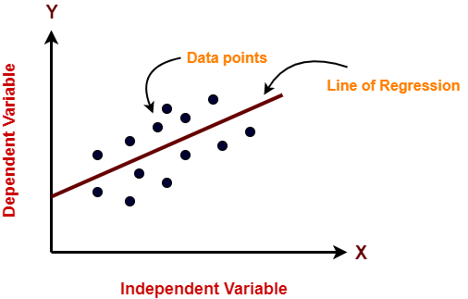
2- Supervised Learning - Regression algorithm
Regression is a technique for investigating the relationship between independent variables or features and a dependent variable or outcome
Algorithm is used to predict continuous outcomes
It is mainly used for prediction, forecasting, time series modeling

Slide 27
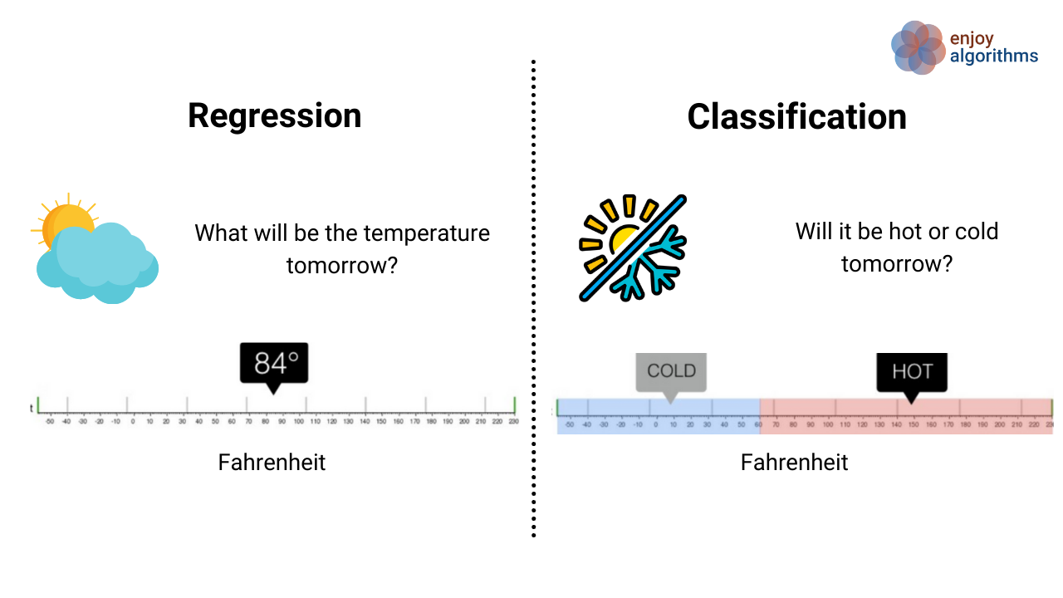
Classification VS Regression - ML

Slide 28
The roadmap for ML
1- Introduction to Machine Learning
2- Types / Approach of Machine Learning
3- Machine Learning Projects / Use Cases
4- Machine Learning Project Life-Cycle
5- ML – The difference between classification Vs regression
6- Unsupervised ML – Clustering Algorithms:
K-means Clustering
7- Supervised ML – Classification and Regression Algorithms:
KNN
Logistic Regression
Support Vector Machine
Decision Tree
Random Forest
Naïve bayes
Linear Regression
8- Deployment ML Models

Slide 29

Unsupervised ML - K-Means Clustering 1
K-Means Clustering is an unsupervised machine learning algorithm
Used to solve the clustering problems
The main goal is to grouping unlabeled dataset into different clusters
K represent the number of pre-defined clusters that need to be created in the process
It is a centroid-based algorithm
Each cluster is associated with a centroid
The k-means clustering algorithm mainly performs two tasks: 1- Determines the best value for K center points or centroids by an iterative process. 2- Assigns each data point to its closest k-center. Those data points which are near to the k-center, create a cluster.

Slide 30
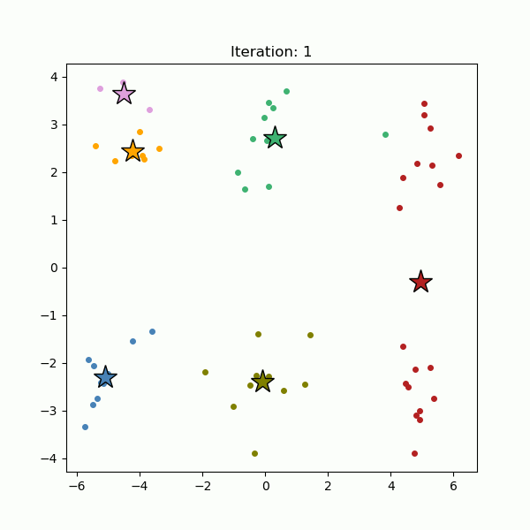
Unsupervised ML - K-Means Clustering 2
How does the K-Means Algorithm Work?
Step-1: Specify number of clusters K.
Step-2: Initialize centroids by first shuffling the dataset and then randomly selecting K data points for the centroids without replacement
Step-3: Keep iterating until there is no change to the centroids. i.e., assignment of data points to clusters isn’t changing.
Step-4: Compute the sum of the squared distance between data points and all centroids.
Step-5: Assign each data point to the closest cluster (centroid).
Step-6: Compute the centroids for the clusters by taking the average of the all data-points that belong to each cluster

Slide 31
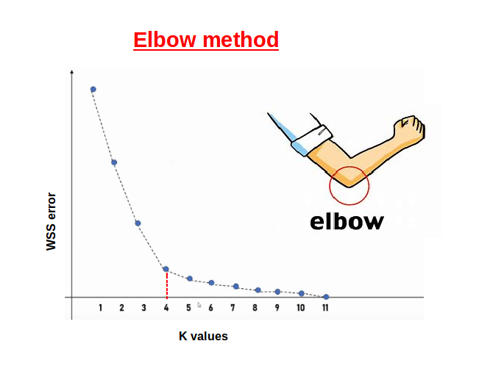
Unsupervised ML - Evaluate K-Means Clustering models 3
How to choose the value of "K number of clusters" in K-means Clustering?
There are some different ways to find the optimal number of clusters
One of the most popular ways to find the optimal number of clusters is Elbow Method
This method uses the concept of WCSS value
WCSS stands for Within Cluster Sum of Squares, which defines the total variations within a cluster

Slide 32
Happy journey coding!
K-Means Clustering

Slide 33
The roadmap for ML
1- Introduction to Machine Learning
2- Types / Approach of Machine Learning
3- Machine Learning Projects / Use Cases
4- Machine Learning Project Life-Cycle
5- ML – The difference between classification Vs regression
6- Unsupervised ML – Clustering Algorithms:
K-means Clustering
7- Supervised ML – Regression and Classification Algorithms:
Linear Regression
KNN
Logistic Regression
Support Vector Machine
Decision Tree
Random Forest
Naïve bayes
8- Deployment ML Models

Slide 34
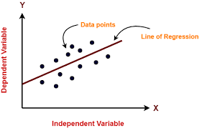
Supervised ML - Linear Regression 1
Linear regression is one of most popular machine learning algorithm
Linear Regression make prediction for continues values such as price, salary, age, ..etc.
Linear regression algorithm shows a linear relationship between a dependent (y) and one or more independent (x) variables
Linear regression model provides a sloped straight line representing the relationship between the variables
Y = a0 + a1 X
Y= Dependent Variable
X= Independent Variable
a0= intercept of the line
a1 = Linear regression coefficient

Slide 35
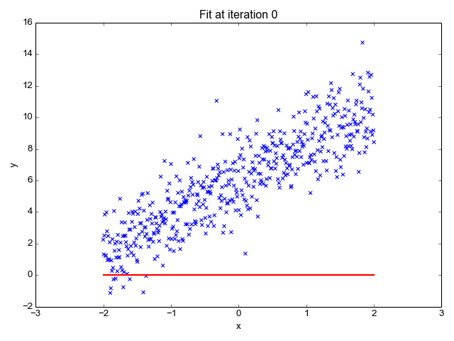
Supervised ML - Linear Regression 2
Best Fit Line The main goal is to find best fit line that represent the minimum error value between actual label value (X) and predicted label )Red line(. With increasing iterations we are getting closer to best Fit Line
The different values for weights or the coefficient of lines (a0, a1) gives a different line of regression
we need to calculate the best values for a0 and a1 to find the best fit line
We use cost function and gradient descent to calculate the error rate and minimize it

Slide 36
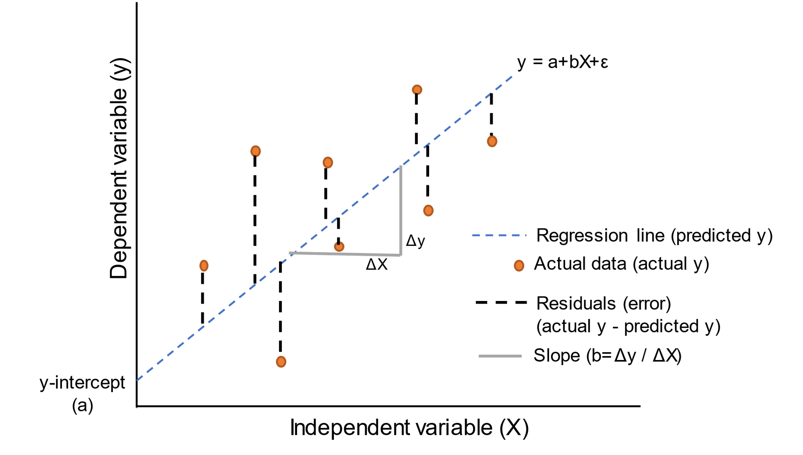
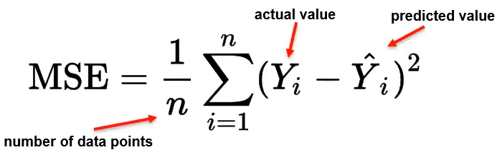

Supervised ML - Linear Regression 3
1- Cost function
Cost function is a measure of how wrong the model is in estimating the relationship between X(input) and Y(output) Parameter
Used to estimate the values of the coefficient for the best fit line
For Linear Regression, we use the Mean Squared Error (MSE) cost function. The closer the number is to zero, the more accurate it is

Slide 37
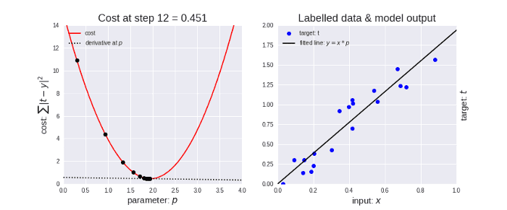
Supervised ML - Linear Regression 4
2- Gradient Descent used to minimize the MSE by calculating the gradient of the cost function
* A regression model uses gradient descent to update the coefficients of the line by reducing the cost function.
* It is done by :
1- Random selection of values of coefficient
2- Iteratively update the values to reach the minimum cost function.

Slide 38
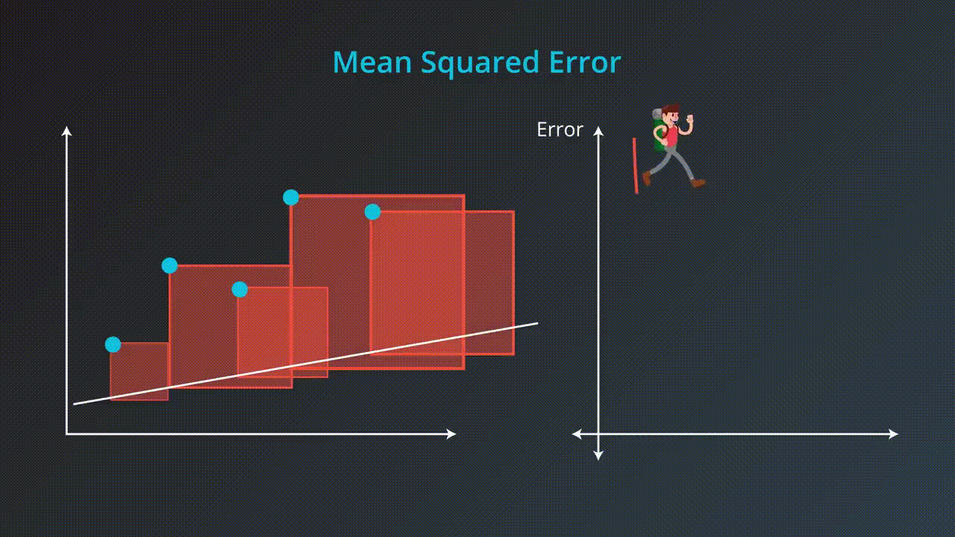
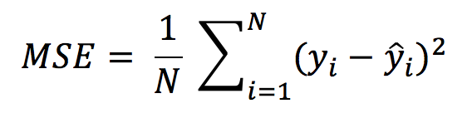
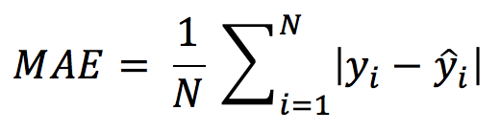
Supervised ML - Evaluate Regression ML Models 5
Metrics to evaluate Regression Model
The closer the number is to zero, the more accurate
Two of the most popular metrics for model evaluation in regression:
Mean Square Error(MSE)
Mean Absolute Error(MAE)

Slide 39
Happy journey coding!
Linear Regression

Slide 40
Supervised ML - K-Nearest Neighbor KNN 1
KNN stands for K-Nearest Neighbor - 1, 7
The algorithm can be used to solve both classification and regression problem
Its aim is to locate all the closest neighbors around a new unknown data point in order to figure out what class it belongs to
KNN referred to as a distance-based algorithm
How do we select the right value of K?
There is no method for determining the correct value of K
The value of K that delivers the best accuracy for both training and testing data is selected
Task: Why is KNN called a “Lazy Learner”?

Slide 41
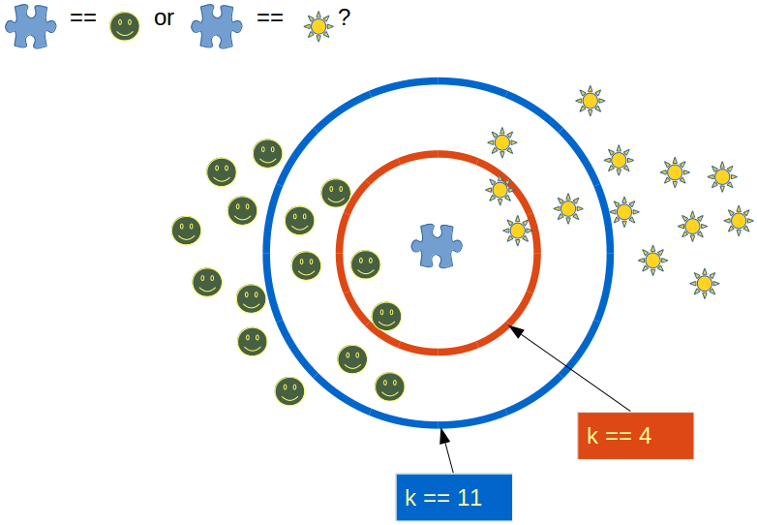
Supervised ML - K-Nearest Neighbor KNN 2
It is recommended to always select an odd value of K
When the value of K is set to even, a situation may arise in which the elements from both groups are equal
Choosing an odd value for K is preferred because such a state of equality between the two classes would never occur here

Slide 42
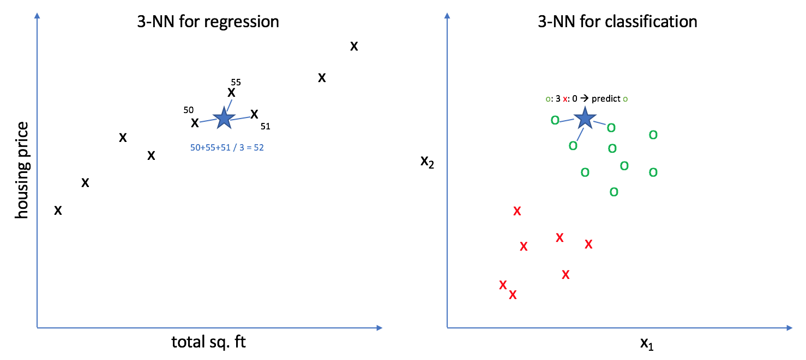
Supervised ML - KNN 3 in Classification and Regression
Classification problem
KNN tends to use the concept of “Majority Voting”
Where the class with the most votes is chosen
Regression
KNN employs an average method for predicting the value of new data

Slide 43
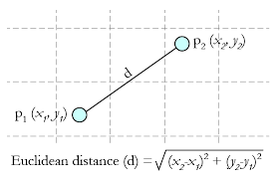
Supervised ML - K-NN 4 How to Calculate Distance?
For calculating distances KNN uses a distance metric from the list of available metrics
Minkowski Distance
Manhattan Distance
Euclidean Distance (most widely used)
Cosine Distance
Euclidean Distance

Slide 44
Supervised ML - KNN 5 Algorithm Steps
Step-1: Select the number K of the neighbors
Step-2: Calculate the Euclidean distance of K number of neighbors
Step-3: Take the K nearest neighbors as per the calculated Euclidean distance.
Step-4: Among these k neighbors, Apply majority voting method (Classification). Apply average method (Regression)
Step-5: Assign the new data points to that category (Classification) for which the number of the neighbor is maximum. (Regression) for the mean value for K neighbors

Slide 45
Happy journey coding!
K-Nearest Neighbor
&
Assignment for K-Nearest Neighbor

Slide 46

Supervised ML - Logistic Regression 1
Logistic regression is a Machine Learning algorithm Used for classification problems
Used for predicting the categorical values use a given set of independent variables
Instead of giving values as 0 and 1, it gives the probabilistic values which lie between 0 and 1
In Logistic regression, instead of fitting a regression line, we fit an "S" shaped logistic function, which predicts two maximum values (0 or 1).

Slide 47
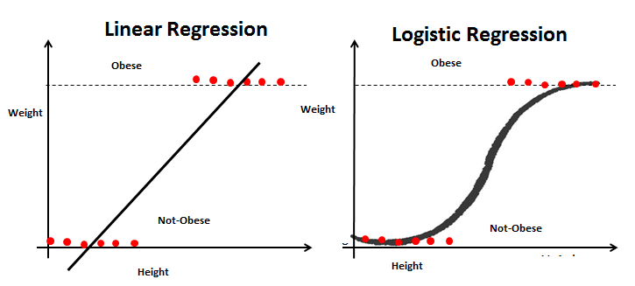
Supervised ML - Logistic Regression 2
Steps of Logistic Regression (Sigmoid Function)
To calculate the binary separation, first, we determine the best-fitted line by following the Linear Regression steps
The predicted value gets converted into probability by feeding it to the sigmoid function.
After feed, the output ŷ value to the sigmoid function it retunes a probability value between 0 and 1
Finally, the output value of the sigmoid function gets converted into 0 or 1(discreet values) based on the threshold value. We usually set the threshold value as 0.5. In this way, we get the binary classification

Slide 48
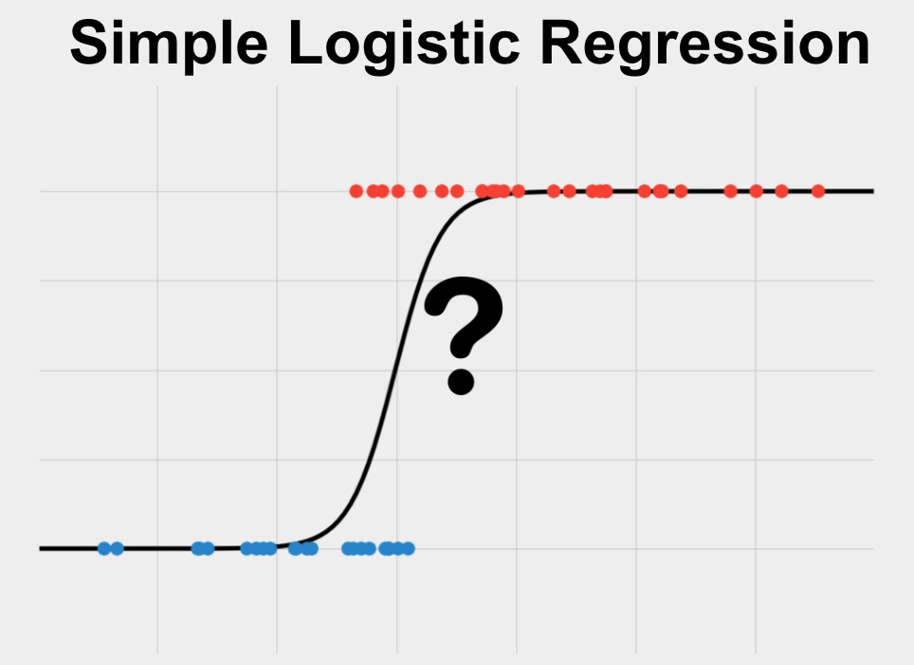
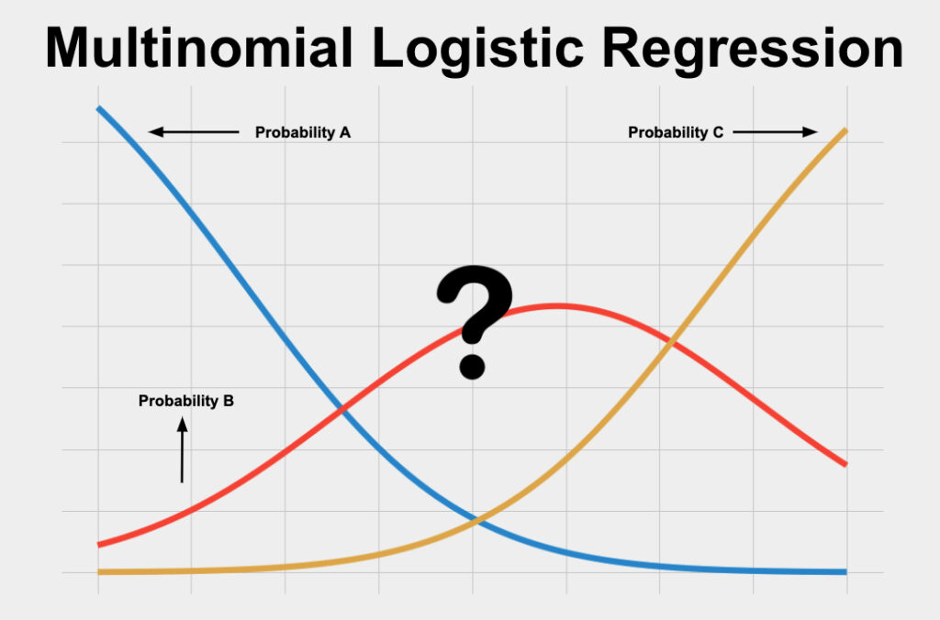
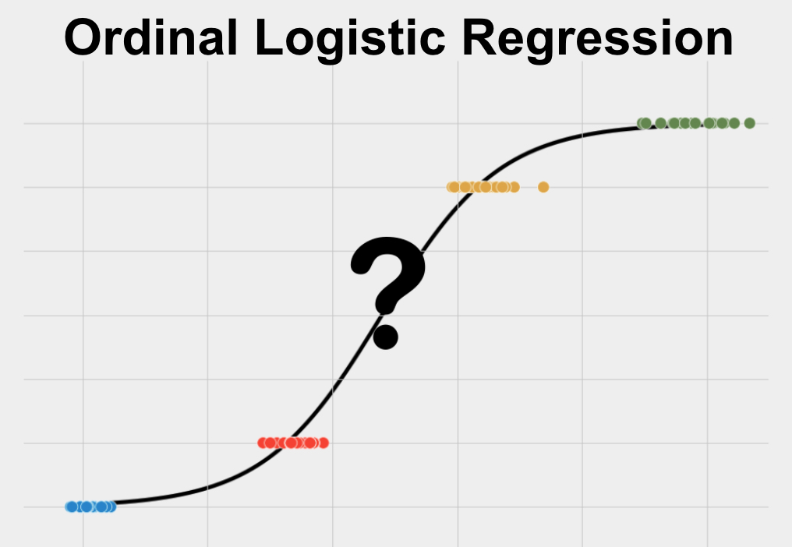
Supervised ML - Logistic Regression 3
* Based on the categories, Logistic Regression can be classified into three types:
1- Simple/Binomial: only two possible types of the dependent variables, such as 0 or 1
2- Multinomial: more than two unordered types of the dependent variable, such as "car", "bus", or "ship"
3- Ordinal: more than two ordered types of the dependent types variables, such as "low", "Medium", or "High".

Slide 49
Supervised ML - Linear Regression VS Logistic Regression 4
Similarities :
Both is a Supervised Machine Learning algorithms.
Both the models use linear equations for predictions
Differences :
Difference | Linear Regression | Logistic Regression
Problems | Regression | Classification
output | continuous | discreet
Cost Function | mean squared error | maximum likelihood-Prob- estimation

Slide 50
Happy journey coding!
Logistic Regression

Slide 51
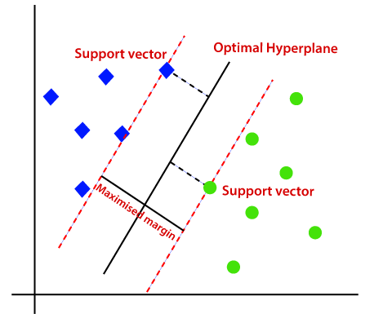
Supervised ML - Support Vector Machine SVM 1
Support Vector Machine or SVM is one of the most popular Supervised Learning algorithms
Used for Classification as well as Regression problems
Primarily, it is used for Classification problems
The goal of the SVM algorithm is to create the best line or decision boundary that can segregate n-dimensional space into classes so that we can easily put the new data point in the correct category in the future
This best decision boundary is called a hyperplane
SVM chooses the extreme points/vectors that help in creating the hyperplane.
These extreme cases are called as support vectors, and hence algorithm is termed as Support Vector Machine.

Slide 52
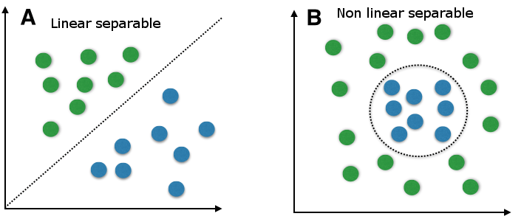
Supervised ML - Support Vector Machine SVM 2
Two types of SVM : 1- Linear SVM: used for linearly separable data, which means if a dataset can be classified into two classes by using a single straight line 2- Non-linear: used for non-linearly separated data, which means if a dataset cannot be classified by using a straight line, then such data is termed as non-linear data

Slide 53
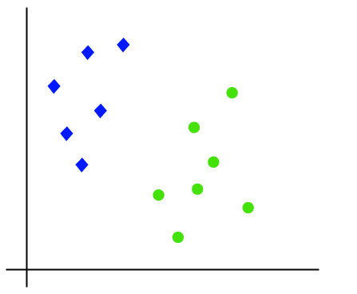
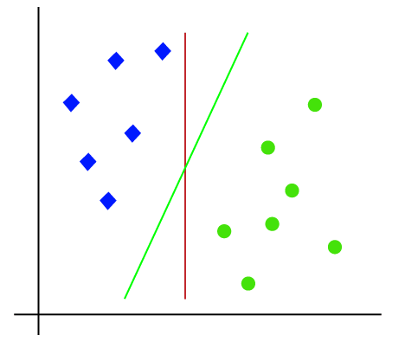
Supervised ML - SVM 3 How does SVM works
1- Linear SVM:
Assume we have a dataset that has two labels (green and blue), and the dataset has two features x1 and x2. We want a classifier that can classify the pair(x1, x2) of coordinates in either green or blue.
We can put multiple lines that can separate these classes
The SVM algorithm helps to find the best line or decision boundary; this best boundary or region is called as a hyperplane
SVM algorithm finds the closest point of the lines from both the classes.
The distance between the vectors and the hyperplane is called as margin.
the goal of SVM is to maximize this margin
The hyperplane with maximum margin is called the optimal hyperplane

Slide 54
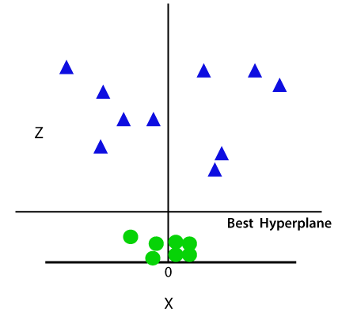
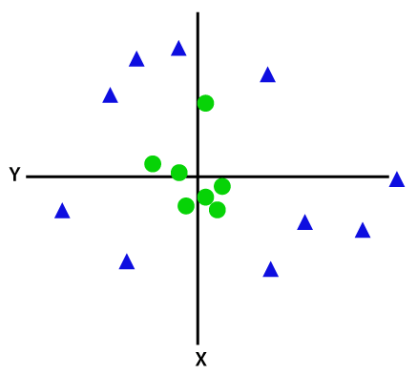
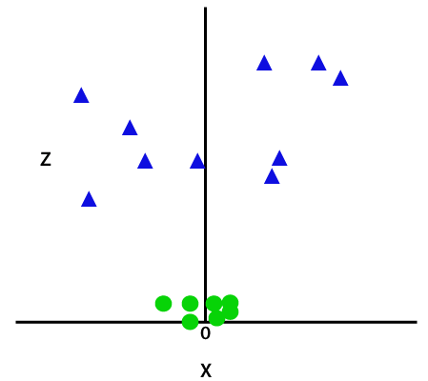
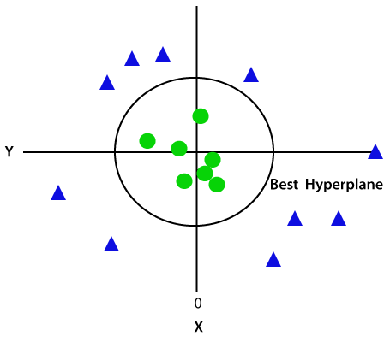

Supervised ML - Support Vector Machine SVM 4
2- Non-Linear SVM:
We cannot draw a single straight line to segregate non-linear data
For linear data, we have used two dimensions x and y
So, for non-linear data, we will add a third-dimension z
It is looking like a plane parallel to the x-axis
z=x^2 +y^2
1
2
Adding the third dimension
SVM will divide the datasets into classes
3
Convert it in 2d space with z=1
We get a circumference of radius 1 in case of non-linear data

Slide 55
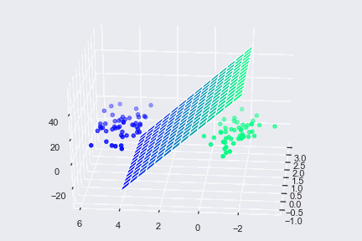
Supervised ML - Support Vector Machine SVM 5

Slide 56
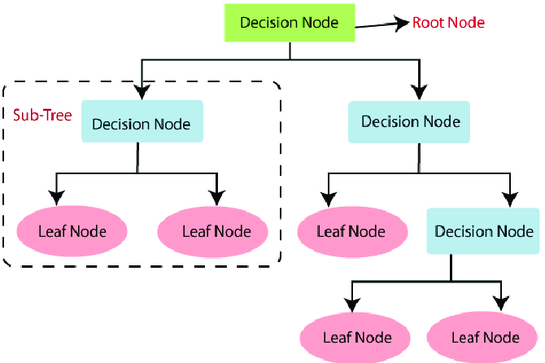
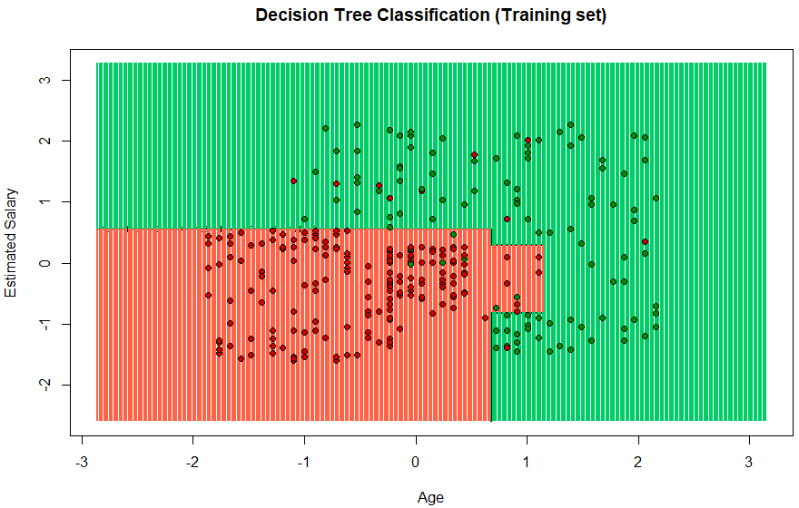
Supervised ML - Decision Tree 1
Decision Tree is a Supervised learning technique that can be used for both Classification and Regression problems
There are two types of nodes in decision tree:
Decision Node : are used to make any decision and have multiple branches
Leaf Node : are the output of those decisions and do not contain any further branches
A decision tree can contain categorical data (YES/NO) as well as numeric data
Notes:
Root Node: Root node is from where the decision tree starts. It represents the entire dataset, which further gets divided into two or more homogeneous sets.
Leaf Node: Leaf nodes are the final output node, and the tree cannot be segregated further after getting a leaf node.
Splitting: Splitting is the process of dividing the decision node/root node into sub-nodes according to the given conditions.
Branch/Sub Tree: A tree formed by splitting the tree.
Pruning: Pruning is the process of removing the unwanted branches from the tree.
Parent/Child node: The root node of the tree is called the parent node, and other nodes are called the child nodes.

Slide 57
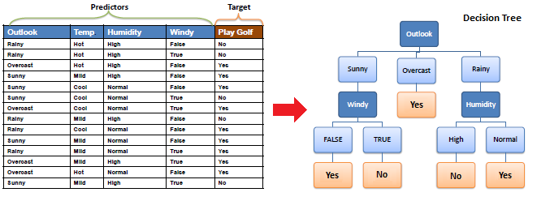
Supervised ML - Decision Tree 2
Example: A decision node (e.g., Outlook) has two or more branches (e.g., Sunny, Overcast and Rainy). Leaf node (e.g., Play) represents a classification or decision.
For more details :
https://www.saedsayad.com/decision_tree.htm

Slide 58
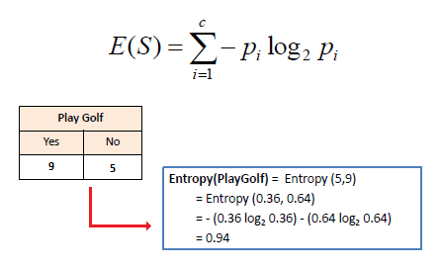
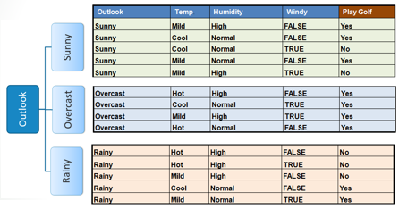
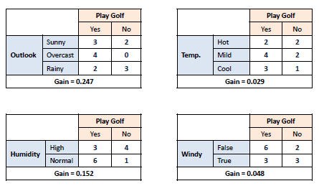
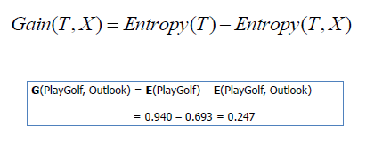
Supervised ML - Decision Tree 3
How to build a Decision Tree?
Step-1: Calculate Entropy for one attribute (Target/Label)
Step-2: For each attribute in the dataset calculate the Entropy for two attributes (feature and target)
Step-3: Calculate Information Gain
Step-4: Choose attribute with largest Information Gain to a decision node
Step-5: Split data based on values in decision node
Step-6: Repeat the steps until reach to leaf nodes
1-Entropy for one attribute
2-Calculate Information Gain for all attributes
5-split data

Slide 59
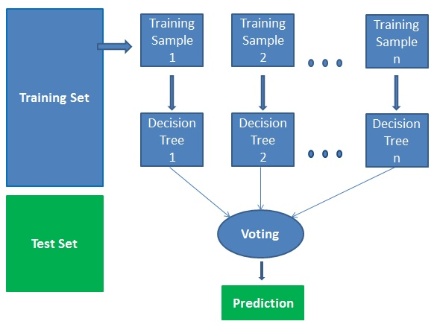
Supervised ML - Random Forest 1
Random Forest is a popular supervised machine learning technique
Random Forest is a classifier that contains number of decision trees on various subsets of the given dataset, then takes the average to improve the predictive accuracy of that dataset
It is based on the concept of ensemble learning
Ensemble learning is a process of combining multiple classifiers to solve a complex problem and to improve the performance of the model
Random Forest takes the prediction from each tree and based on the Majority Votes of predictions, and it predicts the final output

Slide 60
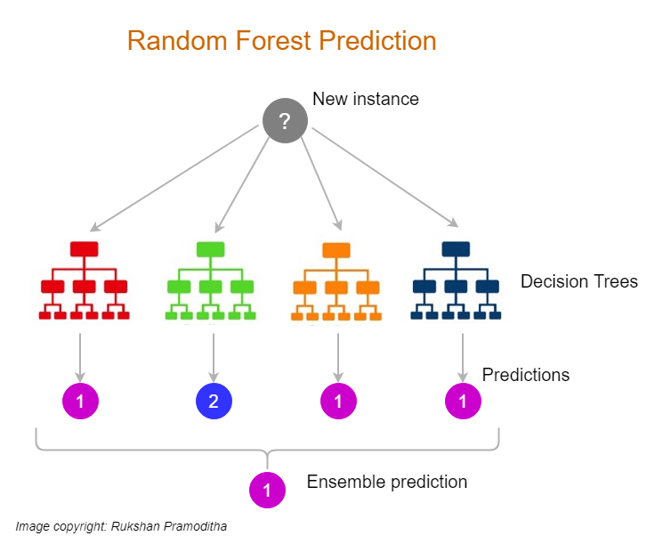
Supervised ML - Random Forest 2
Why use Random Forest?
Takes less training time as compared to other algorithms.
Predicts output with high accuracy, even for the large dataset it runs efficiently
Maintain accuracy when a large proportion of data is missing
How does Random Forest algorithm work?
Step-1: Select random K data points from the training set
Step-2: Build the decision trees associated with the selected data points (Subsets)
Step-3: Choose the number N for decision trees that you want to build
Step-4: Repeat Step 1 & 2
Step-5: Find the predictions of each decision tree
Step-6: Assign the new data points to the category that wins the majority votes

Slide 61


Supervised ML - Naïve Bayes 1
Naïve Bayes is a statistical classification ML algorithm, based on Bayes theorem
It is a probabilistic classifier, which means it predicts based on the probability of an object
We can say “Naïve” because it assumes that the occurrence of a certain feature is independent of the occurrence of other features.
What is a Bayes Theorem? - It’s a rule that used to determine the probability of hypothesis with prior knowledge - It depends in conditional probability
The formula for Bayes' theorem is given as:
P(A|B) – the probability of event A occurring, given event B has occurred
P(B|A) – the probability of event B occurring, given event A has occurred
P(A) – the probability of event A
P(B) – the probability of event B

Slide 62

Supervised ML - Naïve Bayes 2
How Naive Bayes Classifier Works?
Example we'll classify whether players will play or not, based on the weather condition
First Approach (In case of a single feature)
Step 1: Calculate the prior probability for given class labels
Step 2: Find Likelihood probability with each attribute for each class
Step 3: Put these value in Bayes Formula and calculate posterior probability.
Step 4: See which class has a higher probability, given the input belongs to the higher probability class.
Probability of playing:
P(Yes | Overcast) = P(Overcast | Yes) P(Yes) / P (Overcast)
P(Overcast) = 4/14 = 0.29
P(Yes)= 9/14 = 0.64
P (Yes | Overcast) = 0.44 * 0.64 / 0.29 = 0.98
Probability of not playing:
P(No | Overcast) = P(Overcast | No) P(No) / P (Overcast)
P(Overcast) = 4/14 = 0.29
P(No)= 5/14 = 0.36
P (No | Overcast) = 0 * 0.36 / 0.29 = 0

Slide 63

Supervised ML - Naïve Bayes 3
There are three types of Naive Bayes Model, which are given below:
1- Gaussian: The Gaussian model assumes that features follow a normal distribution. This means if predictors take continuous values instead of discrete, then the model assumes that these values are sampled from the Gaussian distribution. Such as Salary and experience
2- Multinomial: It is primarily used for document classification problems * Spam Email: The classifier uses the frequency of words for the predictors. Such as: (Dear shadi, how are you) == (1 5 1 3 2 8)
3- Bernoulli: The Bernoulli classifier works like the Multinomial classifier, but the predictor variables are the independent Booleans variables. Such as: (Dear shadi, how are you) == (1 1 1 0 1 0)

Slide 64

Data Imbalance - EDA

Slide 65

Data Imbalance - EDA

Slide 66

Data Imbalance - EDA

Slide 67

Supervised ML - Evaluate Classification ML Models
The most important task in building any machine learning model is to evaluate its performance
So, how would one measure the success of a machine learning model?
There are different metrics for the tasks of classification and regression
Classification Metrics - 70% Training & 30% Testing-
Classification is about predicting the class labels given input data
most popular metrics for evaluate classification model :
Confusion Matrix
Accuracy
Precision
Recall
F1-Score

Slide 68

Supervised ML - Confusion Matrix
Confusion Matrix in Machine Learning
The confusion matrix is a matrix used to determine the performance of the classification models for a given set of test data.
It can only be determined if the true values for test data are known
For the 2 prediction classes of classifiers, the matrix is of 2*2 table, for 3 classes, it is 3*3 table, and so on
The matrix is divided into two dimensions, that are predicted values and actual values along with the total number of predictions
True Negative: prediction value No, actual value No.
True Positive: prediction value Yes, actual value Yes.
False Negative (Type 2 error): prediction value No, actual value Yes.
False Positive (Type 1 error): prediction value Yes actual value No.

Slide 69


Supervised ML - Calculations in Confusion Matrix
F-measure: If two models have low precision and high recall or vice versa, it is difficult to compare these models.
So, for this purpose, we can use F-score
This score helps us to evaluate the recall and precision at the same time.
The F-score is maximum if the recall is equal to the precision
Out of all positive classes that have predicted correctly by the model, how many of them were actually true
It is defined as the out of total positive classes, how our model predicted correctly. The recall must be as high as possible.
How often the model predicts the correct output

Slide 70

Differences between ML types

Slide 71
The roadmap for ML
1- Introduction to Machine Learning
2- Types / Approach of Machine Learning
3- Machine Learning Projects / Use Cases
4- Machine Learning Project Life-Cycle
5- ML – The difference between classification Vs regression
6- Unsupervised ML – Clustering Algorithms:
K-means Clustering
7- Supervised ML – Classification and Regression Algorithms:
KNN
Logistic Regression
Support Vector Machine
Decision Tree
Random Forest
Naïve bayes
Linear Regression
8- Deployment ML Models

Slide 72

ML – Deployment ML Models
What Is Machine Learning Model Deployment?
Is the process of placing a finished ML model into a live environment where it can be used for its intended purpose.
Models can be deployed in a wide range of environments, and they are often integrated with apps through an API so they can be accessed by end users
Prepare To Deploy the ML Model
Training ML model
This involves selecting an algorithm, setting its parameters and training it on prepared, cleaned data
Validate the ML Model
Once a model has been trained and its results have been deemed successful, it needs to be validated to ensure that its one-time success was not an anomaly.
Deploy the ML Model
The model needs to be moved into its deployed environment, where it has access to the hardware resources (CPU/GPU, ..etc.) it needs as well as the data source that it can draw its data from.
Second, making it accessible from an end user’s laptop using an API or integrating it into software currently being used by the end user.

Slide 73
Happy journey coding!
Application of all algorithms in classification -Titanic

Slide 74
Happy journey coding!
Spam Email - Nive bayes

Slide 75
Happy journey coding!
Prediction of Diabetes –
Application of all classification algorithms

Slide 76
Machine learning
Thanks
For Your Attention

